Slide 1
Spring Co-Op Presentation
By Tyler Karpowicz

Slide 2


Who is Tyler Karpowicz?
From Sayville, New York - Long Island
Sys Admin Intern for Raytheon Intelligence and Space at BBN
Currently Pursuing a Major in Cybersecurity with Minors in Computer Science and Computer Networking, at Wentworth Institute of Technology
Currently in my Junior Year

Slide 3

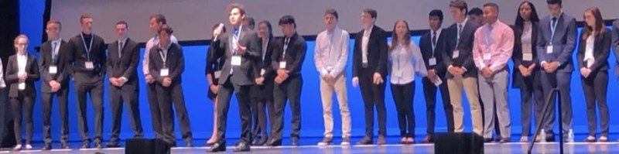
Who is Tyler Karpowicz?
Business Experience: CEO of a Virtual Company at Sayville High School
Managed and Oversaw all Business Operations
Prepared Presentations and Pitches for Judges in Front of a 10,000+ Person Crowd
Made Trade Deals with other Virtual Businesses at Trade Shows, Nationally, and Overseas.
Placed in the Top 150 Businesses Nationally for Virtual Enterprise International.
Extra Skills: Game Development, Computer Maintenance / Repair, and Media Production (YouTube)
Game Development: Unreal Engine 4, Radiant (Call of Duty Black Ops 3)

Slide 4
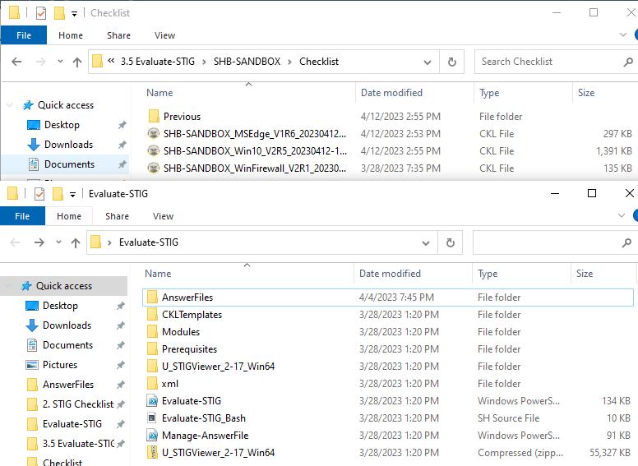
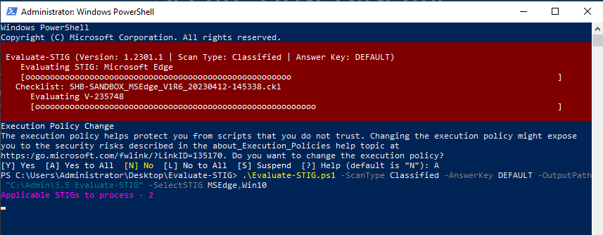
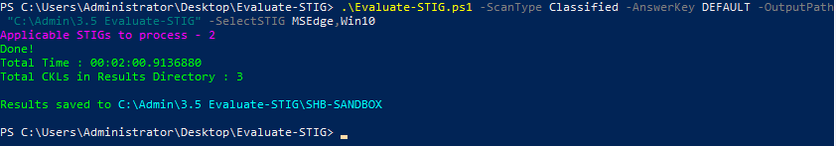
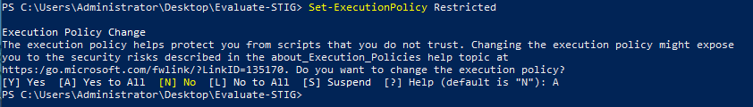
Evaluate-STIG Presentation
Gave an In-Depth Presentation and Demonstration on Evaluate-STIG for BBN-BI-Staff
Evaluate-STIG File Directories
Showing How to Utilize Evaluate-STIG

Slide 5
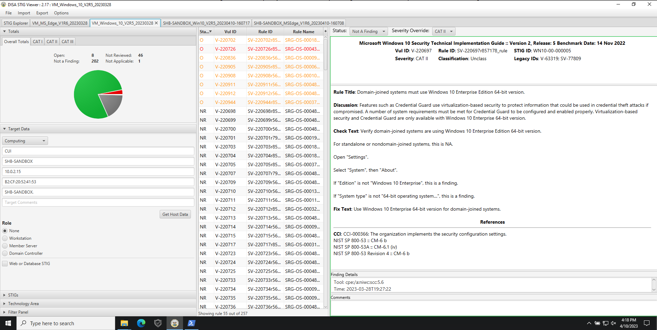
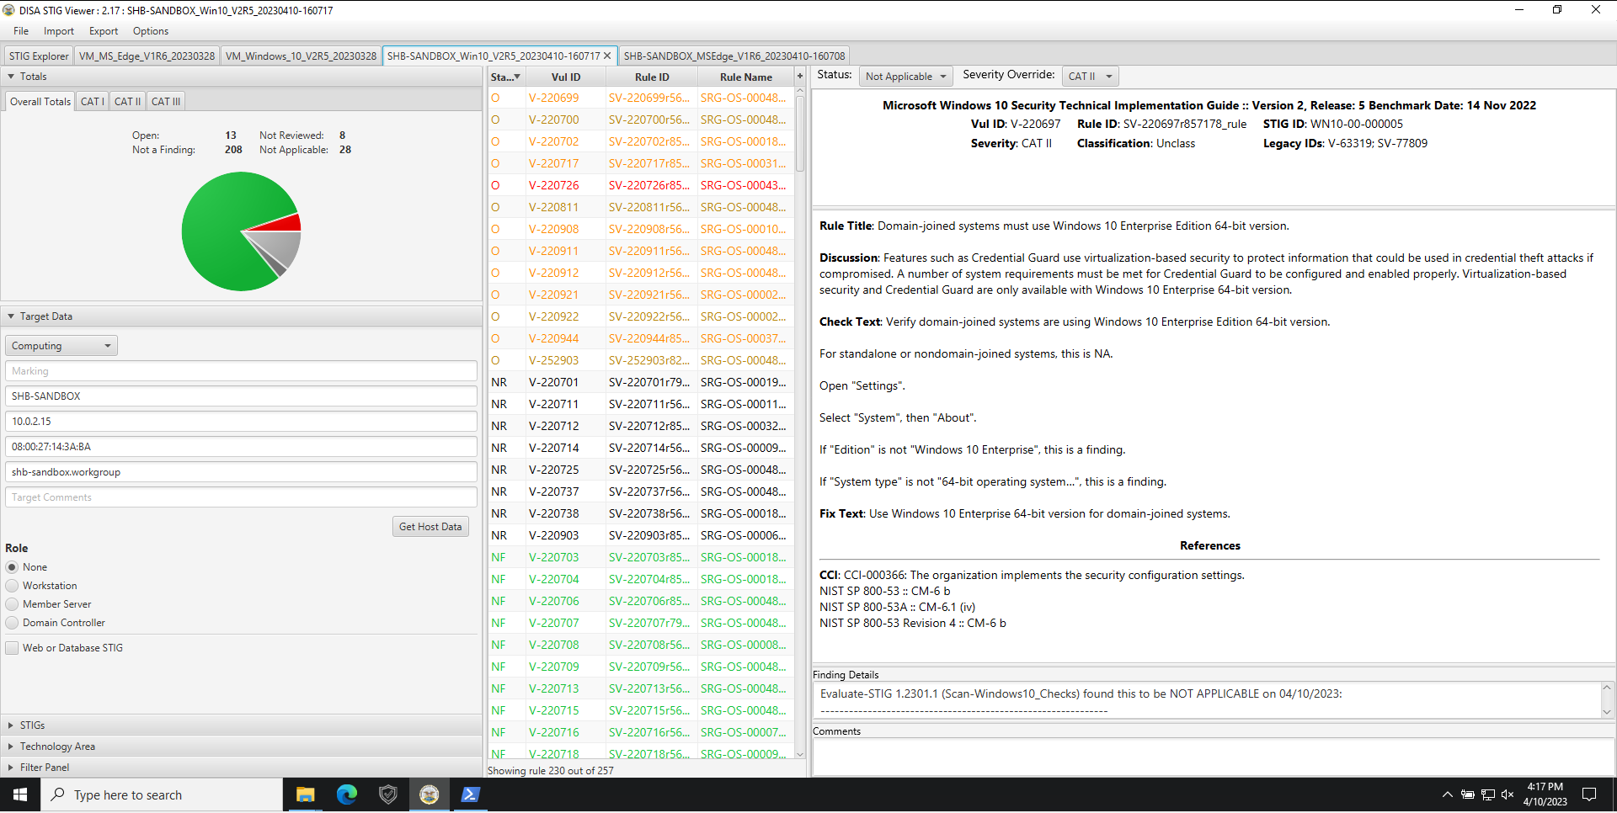
Evaluate-STIG Presentation
Showed Examples on how Evaluate-STIG can Drastically Increase the Efficiency of the Hardening Process
For the Windows 10 STIG
Traditional SCAP/STIG: 8 Open, 46 Not Reviewed
Evaluate-STIG: 13 Open, 8 Not Reviewed
54 Manual Items
21 Manual Items

Slide 6
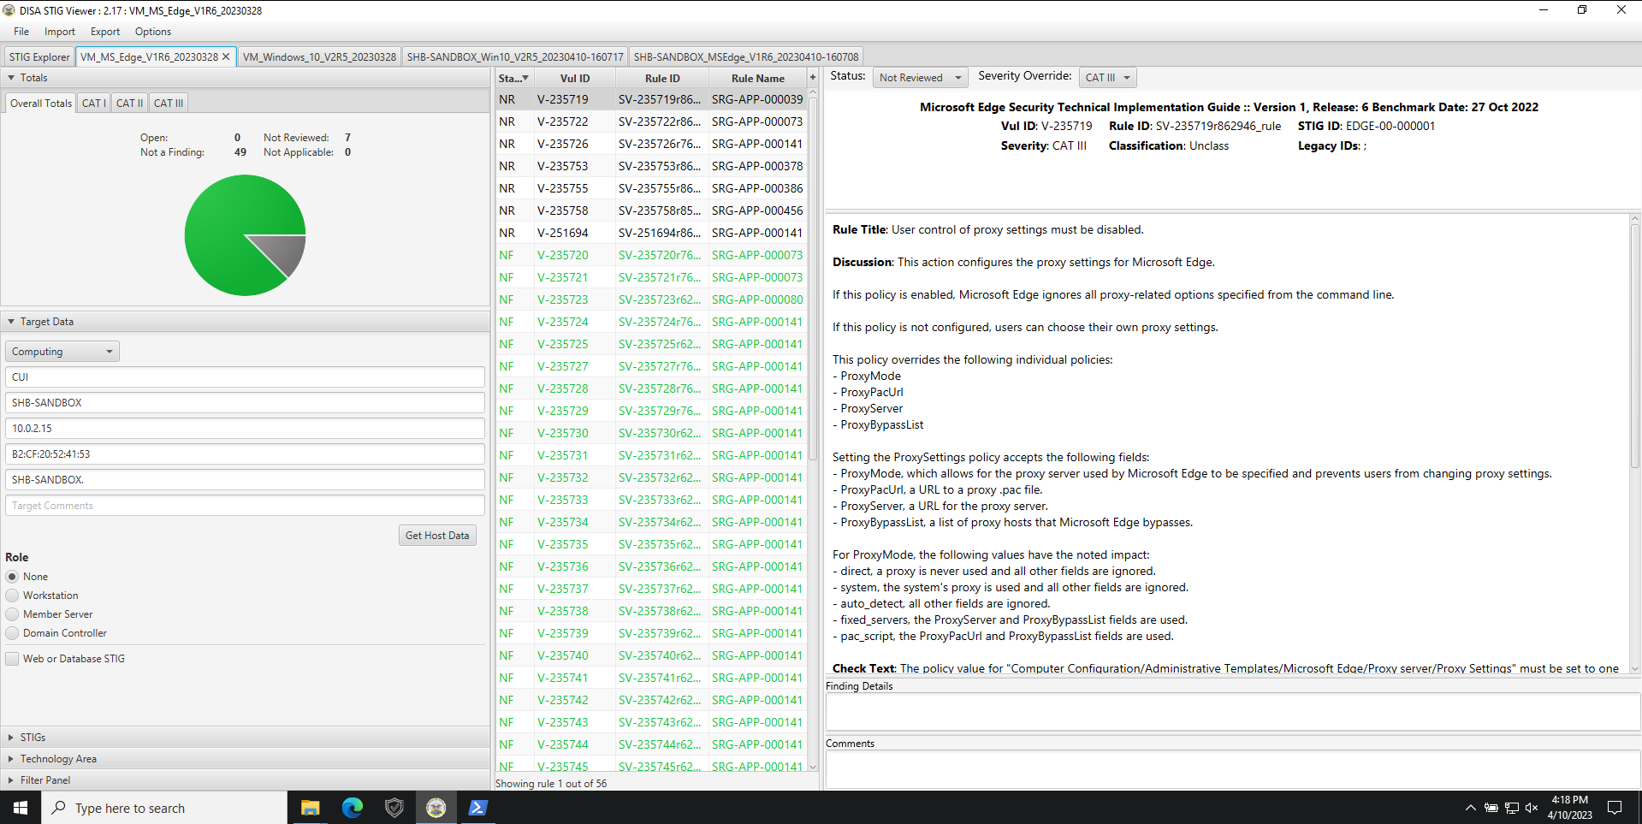

Evaluate-STIG Presentation
Showed Examples on how Evaluate-STIG can Drastically Increase the Efficiency of the Hardening Process
For the Microsoft Edge STIG
Traditional SCAP/STIG: 0 Open, 7 Not Reviewed
Evaluate-STIG: 0 Open, 0 Not Reviewed
7 Manual Items
0 Manual Items

Slide 7
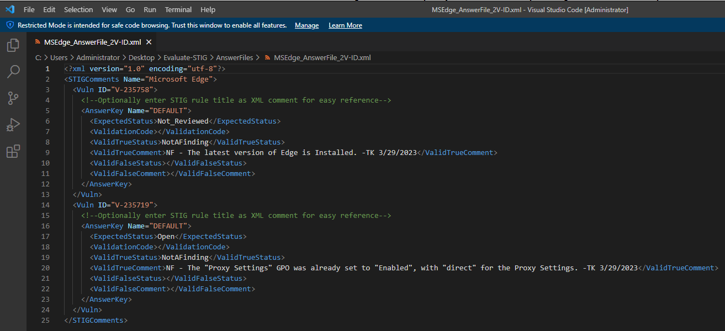
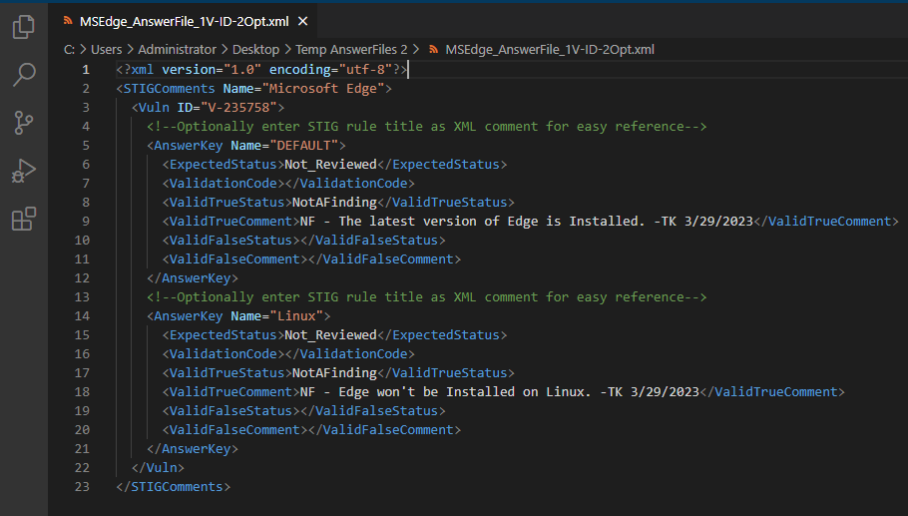
Evaluate-STIG Presentation
Showed Examples of Evaluate-STIG AnswerFiles
Explained Components of Evaluate-STIG AnswerFiles
Showed How to Use Evaluate-STIG AnswerFiles
Microsoft Edge AnswerFile with 2 Vulnerability IDs
Microsoft Edge AnswerFile with 2 Options

Slide 8

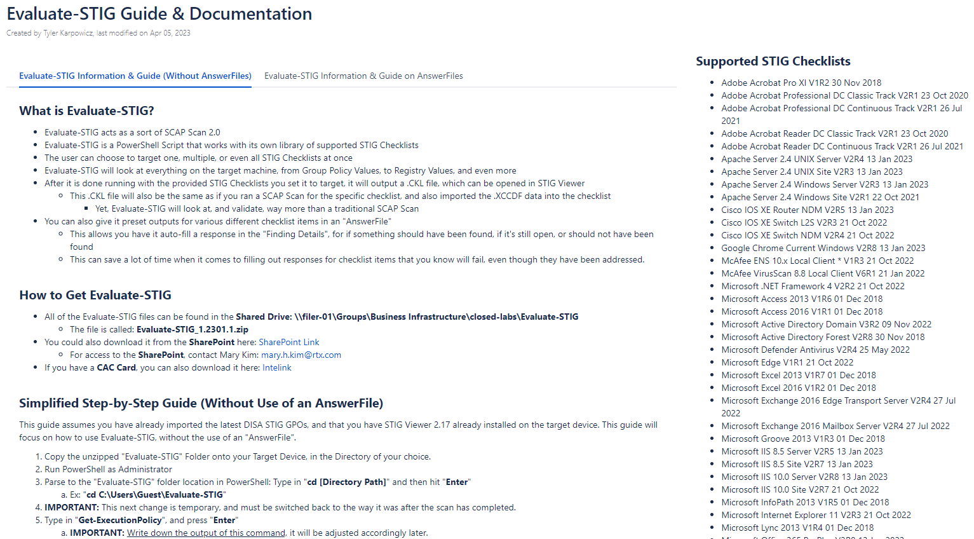
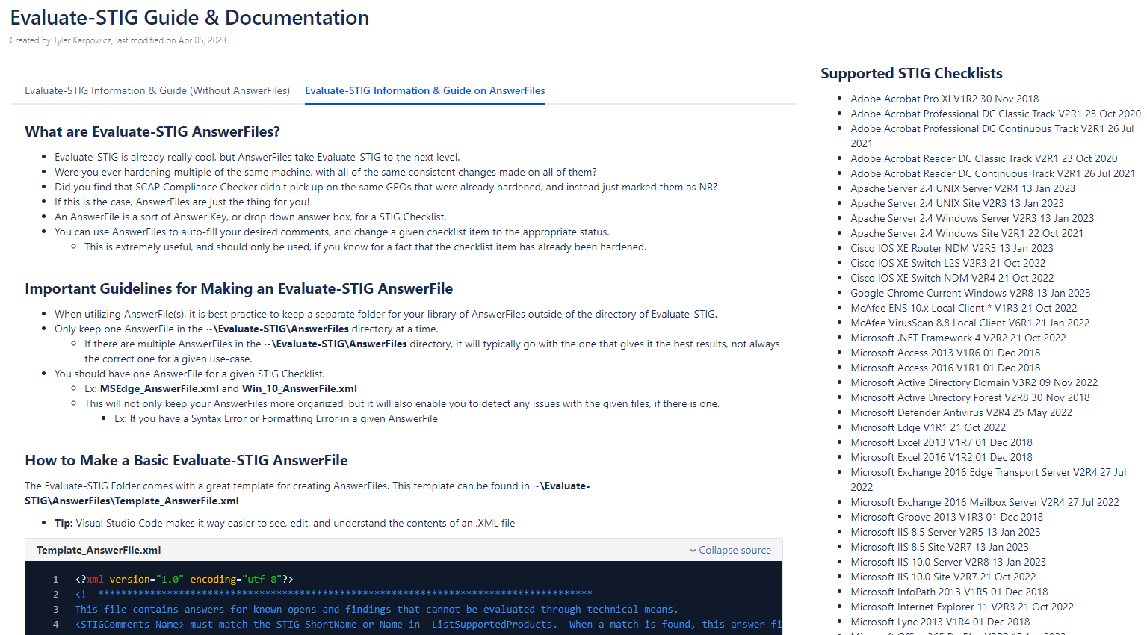
Evaluate-STIG Documentation
Created a Guide and Documentation on Collab for Evaluate-STIG
What is Evaluate-STIG?
How to Get Evaluate-STIG
How to Use Evaluate-STIG
Added a Section for Evaluate-STIG Answer Files
What are Evaluate-STIG AnswerFiles?
Important Guidelines for Making an Evaluate-STIG AnswerFile
How to Make an Evaluate-STIG AnswerFile
How to Use an Evaluate-STIG AnswerFile
Evaluate-STIG AnswerFile Word Bank

Slide 9
Learning at BBN
Workday Trainings
Learning (Outside of Workday Trainings)
Seminars & Information Sessions
Labor Reporting & Compliance
General Awareness of U.S. and European Export Controls
RTime Time Reporting for Employees
Cyber Security Awareness (Ethics Compliance Education Center)
Machine Shop Safety
Personal Protective Equipment
Toxic Metals Awareness
Hazardous Waste Awareness
Hazard Communication
RTXConnections Social Access Requirement
Atlassian Tools Tour
Intro to Slurm
Tour of Bolt
EHSS Orientation Checklist
BSP GPO / Symantec Setup
Learned about the Process and Procedures associated with Network Mapping
RTX CSS Lunch & Learn - Evaluate - STIG Overview and Demonstration
Confluence Macros
Seminar: “Pizza with ChatGPT or: How I Learned to Stop Worrying and Love the Bot.”
Risk Management Framework (RMF) Continuous Monitoring Plan and Strategy Discussion
Synthetic Biology SDP Seminar: Unlocking the Hidden World of Scent with Canaery
Government Property Compliance Seminar
Fun with GPT3: Writing Code
SDP Networks Seminar: Transmit Beamforming Over Acoustic Channels: Is Space Division Multiple Access the Next Goal?

Slide 10


Build Room
Backstage Pass
Learned how to Keep Track of Company Assets (Asset Tags and Hard Drive Serial Numbers)
Assisted with Implementing LDAP for Symantec
SAPTS
Setup Build Room Servers
Installed Windows Server 2019
Installed SCAP Compliance Checker and STIG Viewer
Conducted SCAP Scans on a Server
Utilized STIG Viewer to Harden a Server
Utilized Active Directory to Make New User Accounts & Installed Necessary Tools

Slide 11
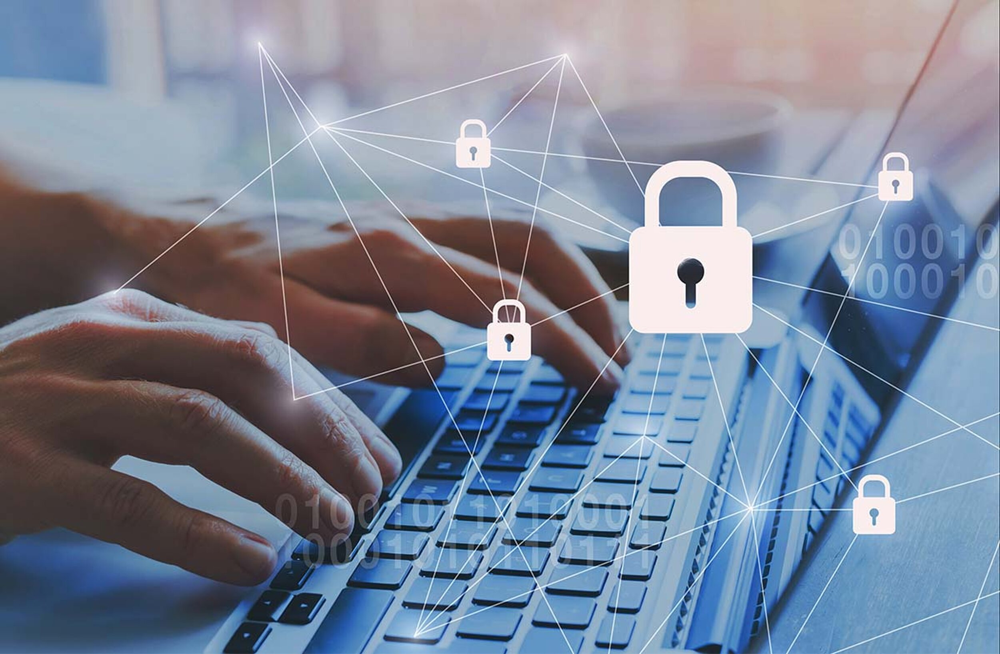
Hardening Client Laptops (6 Total)
Installed Drivers
Installed Requested Programs
Preformed Symantec Anti-Virus Scans (Full and Active Scans)
Created GPO Backups
Utilized the DISA STIG GPO Package, and Arun’s GPO Package
Utilized Evaluate-STIG and Evaluate-STIG AnswerFiles
Installed / Licensed Tenable Nessus
Troubleshooted & Fixed a Variety of Issues Along the Way
Installed and Utilized SCAP Compliance Checker & STIG Viewer
MS_Edge
Windows Firewall
Windows 10
Adobe Acrobat Reader Continuous DC
Microsoft Word 2016
Microsoft PowerPoint 2016
Microsoft Excel 2016

Slide 12
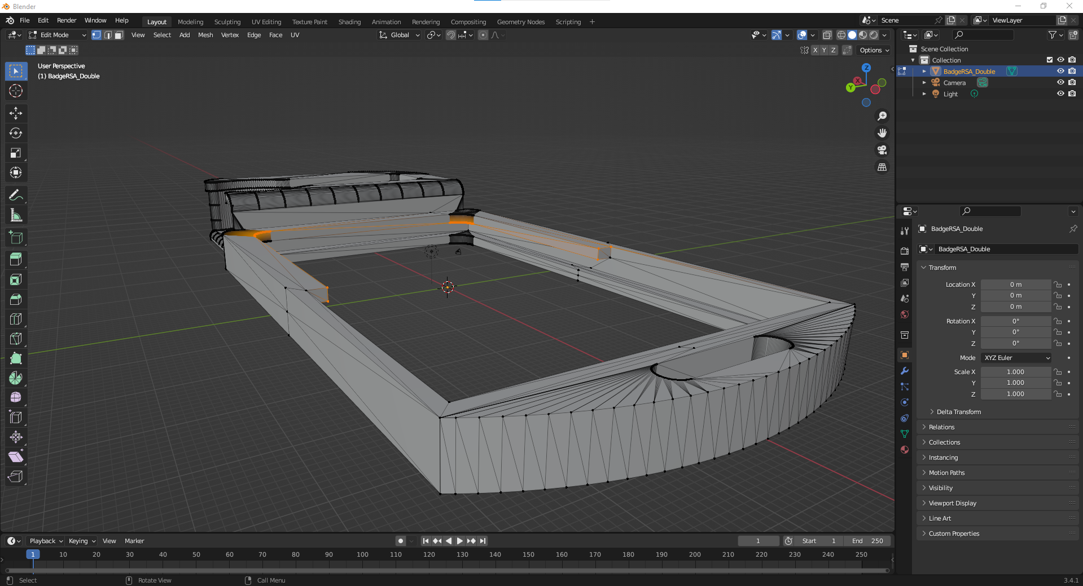
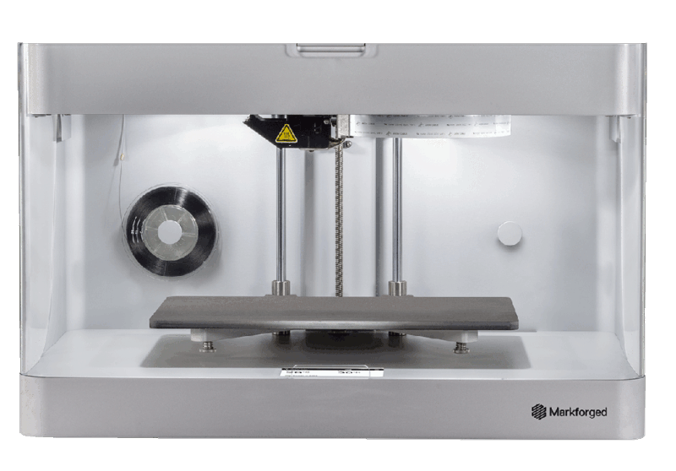
Maker Space
Obtained Clearance for Maker Space
Completed all Necessary Trainings
Machine Shop Safety
Personal Protective Equipment
Toxic Metals Awareness
Hazardous Waste Awareness
Hazard Communication
Created an Account for Eiger, to Utilize the 3D-Printers
3D-Printed an ID Badge-Holder Model from Thingiverse
Learned and Utilized Blender to Edit a .STL File from Thingiverse, to Fix Dimensional Issues
3D-Printed 3 Copies of the Blender-Corrected ID Badge-Holder .STL File

Slide 13
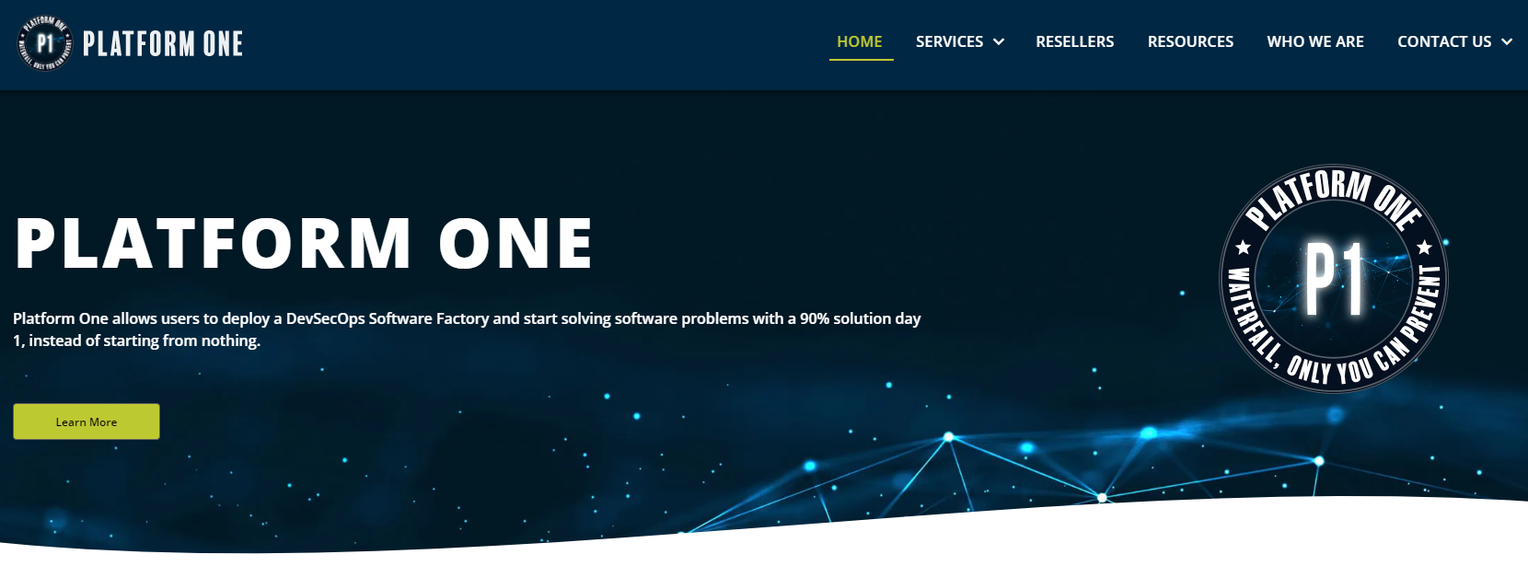
Platform One
Researched and Reviewed Documentation on the Platform One Website
Communicated Questions and Concerns about Platform One with Sys Admin Colleagues
Collected a Variety of Thoughts, Questions, and Concerns, and Reached out to a Platform One Reseller

Slide 14
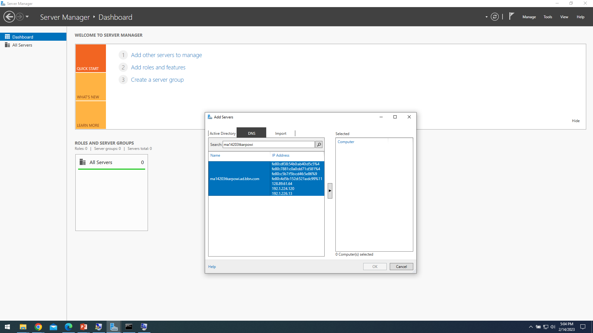

Completed HELP Tickets on JIRA
Setup Windows Administrative Tools / Remote Server Admin Tools
Explore BI Documentation
Explore IPAM Documentation
Test out PXE Booting
Tested out PXE Booting a Laptop in the 5th Floor Build Room.

Slide 15
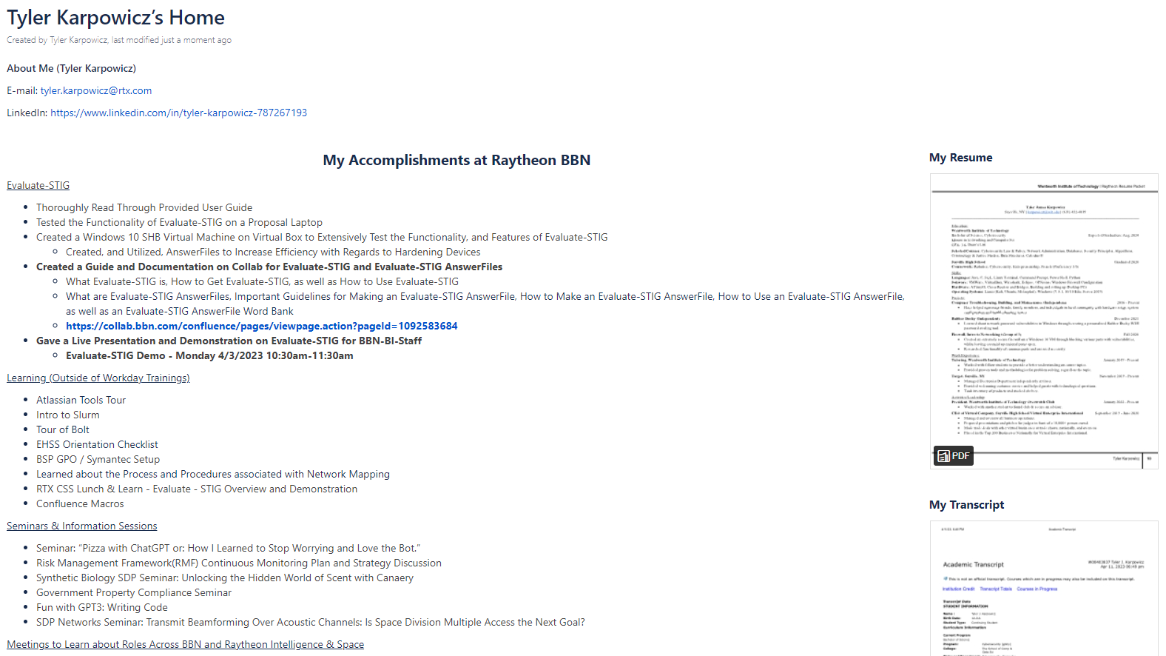
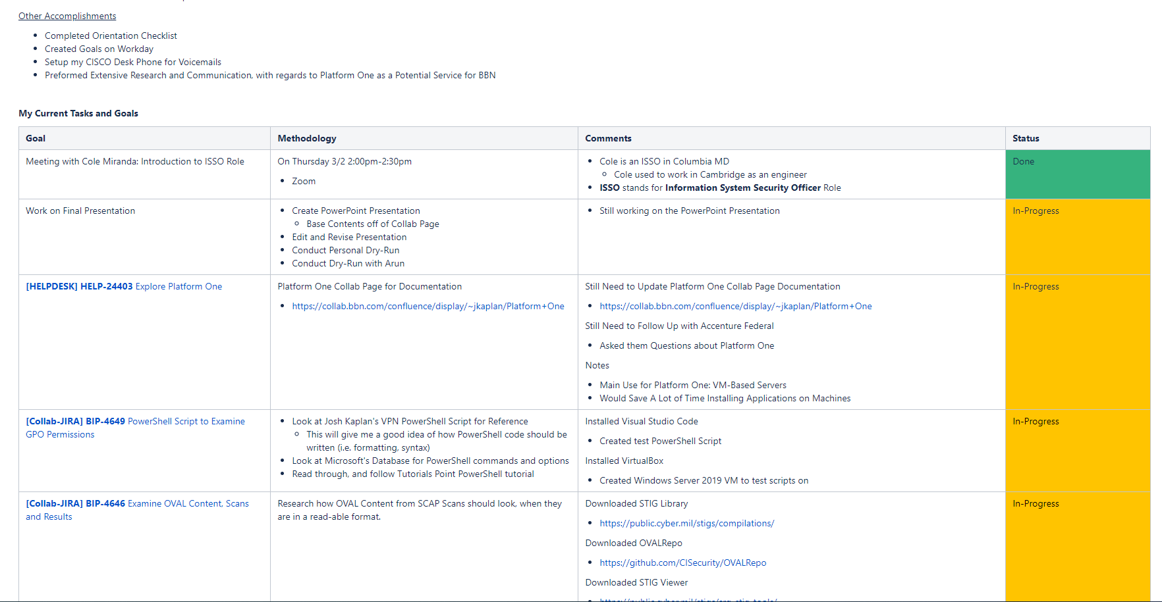
Personal Collab Page & Other Accomplishments
Created my own Collab Page
Shows my Skills / Experience
What I have Accomplished at BBN
My Current Goals, and their Status
Shoutout to Arun for the Idea!
Other Accomplishments
Completed Orientation Checklist
Created Goals on Workday
Setup my CISCO Desk Phone for Voicemails

Slide 16
Thank you Everyone for Helping me along the way!!
Peter
Arun
Bobby
Frank
Ed
Vanessa
Curtis
Robert
Arda
Josh
Will
Patrick
George
Jacob
Noah
Alejandro
Matt

